Slide 1

METROPOLITAN LIBRARY SYSTEM Compensation/Classification and Performance Management Studies Employee Survey
PREPARED BY THE SINGER GROUP, INC.
April, 2017

Slide 2
Survey
Received 423 total responses; 86% ☺ ☺ response rate
Distribution: Online (SurveyMonkey)
Areas covered –
  Compensation
  Classification
  Performance Management
Please note when reviewing the summary that the numbers in parentheses after a statement indicate the number of individuals making the same or a similar statement.

Slide 3
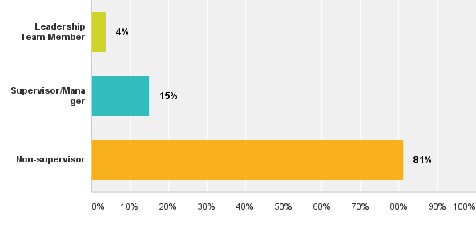
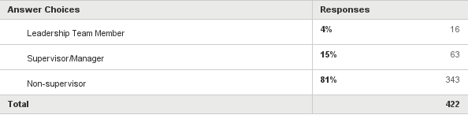
Which of the following best describes your role?
Supervisor/
Manager

Slide 4
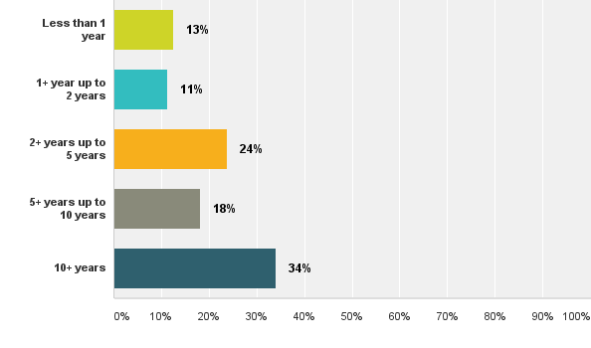
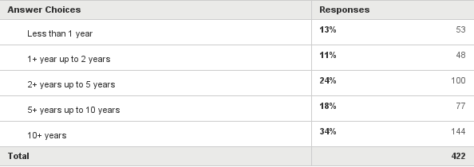
How long have you worked for the Metropolitan Library System (any position)?

Slide 5
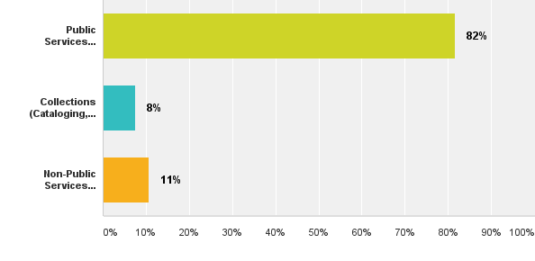
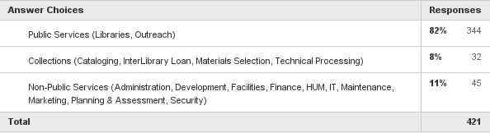
Where are you based?
Public Services
Collections
Non-Public Services
Notes:
Public Services (Libraries, Outreach)
Collections (Cataloging, InterLibrary Loan, Materials Selection, Technical Processing)
Non-Public Services (Administration, Development, Facilities, Finance, HUM, IT, Maintenance, Marketing, Planning & Assessment, Security)

Slide 6
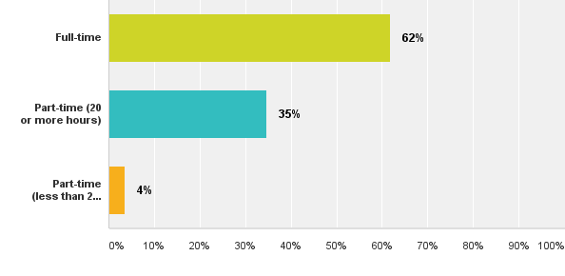
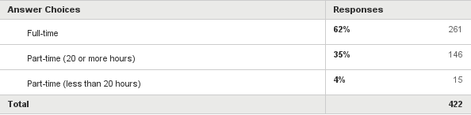
Are you?
Part-time (less than 20 hours)

Slide 7
COMPENSATION/
CLASSIFICATION

Slide 8
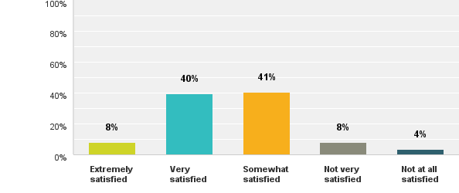
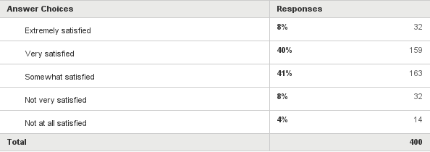
How satisfied are you with your salary at Metro?

Slide 9
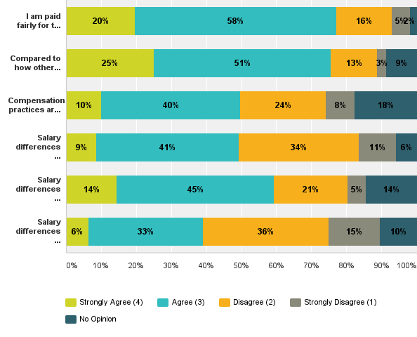
Opinions About Compensation at Metro
I am paid fairly for the work I do.
Compared to how other employers
in the area pay, I am paid fairly.
Compensation practices are
administered consistently for all
employees at the Library.
Salary differences are reflective of
job responsibility and difficulty.
Salary differences are reflective
of seniority.
Salary differences are reflective
of performance.

Slide 10
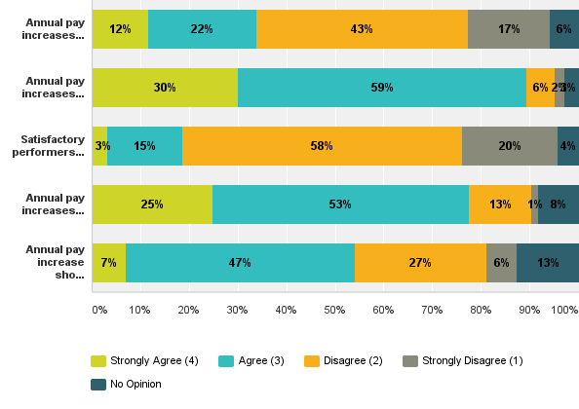
Opinions About Annual Pay Increases at Metro
Annual pay increases should be the
same % for all employees.
Annual pay increases should vary,
depending on employee performance.
Satisfactory performers should receive
the same increase as outstanding
performers.
Annual pay increases should be based
on the Cost of Living.
Annual pay increase should be based
on the market (e.g. other libraries or
similar organizations).

Slide 11
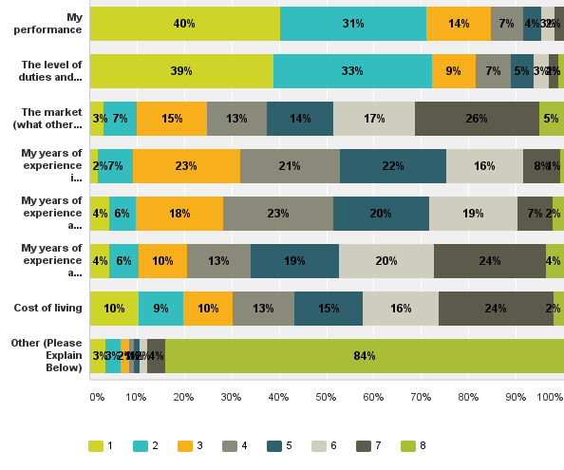
Annual Pay Increases Should Be Based On:
My performance
The level of duties and responsibilities
of my position
The market (what other employees in
other libraries or organizations are
paid for similar positions)
My years of experience in
my current job
My years of experience at the Library
My years of experience at the Library
as well as at previous jobs
Cost of living
Other (Please see next slide)
1 = most important; 8 = least important

Slide 12
Annual Increases Should Be Based On: “Other” responses…
84% of staff listed the following as important but in 8th priority
Cost of living and performance increase (7)
Education (6)
Attendance (4)
Knowledge, skills and abilities (2)
Special skills e.g. bilingual (2)
Flexibility
Notes:
138 comments
Most re-iterated performance

Slide 13
PERFORMANCE MANAGEMENT

Slide 14
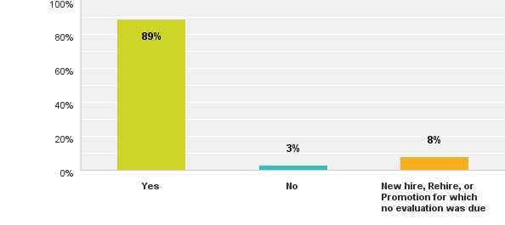
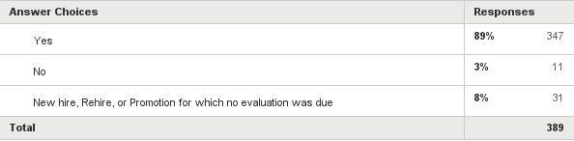
Has your supervisor formally evaluated your performance in the past year?

Slide 15
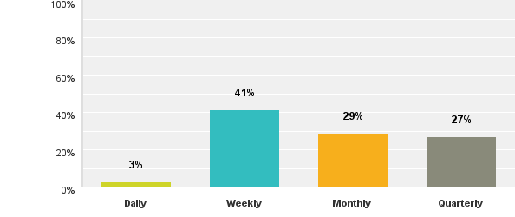
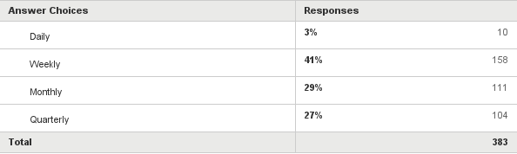
Outside of the performance evaluation process, how often do you receive feedback from your supervisor on your performance?

Slide 16
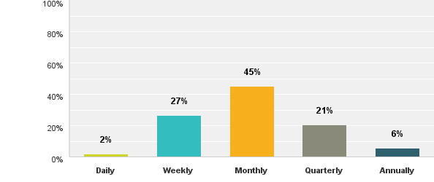
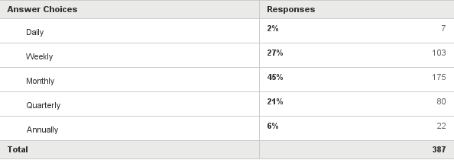
How often would you like to receive feedback from your supervisor on your performance?

Slide 17
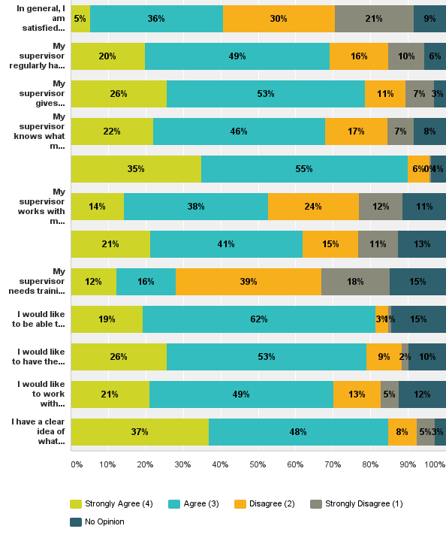
Opinions About Performance Management At Metro
In general, I am satisfied with the Library’s performance review program.
My supervisor regularly has meaningful conversations with me about my performance.
My supervisor gives constructive feedback.
My supervisor knows what my career goals are.
I know what my career goals are.
My supervisor works with me to create a
plan for my professional development.

Slide 18
Opinions About Performance Management At Metro, cont.
My supervisor does a good job of recognizing staff whose perf. exceeds expectations.
My supervisor needs training in
performance management.
I would like to be able to share feedback
with my supervisor.
I would like to have the opportunity to meet
with my supervisor regularly throughout the year to discuss my performance.
I would like to work with my supervisor to set quarterly or annual goals for my position.
I have a clear idea of what good performance
looks like in my job at the Library.

Slide 19
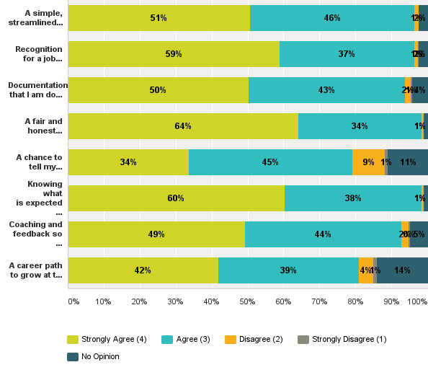
What would you like to get out of the performance review process?
A simple, streamlined
evaluation process
Recognition for a job well-done
Documentation that I am doing a good job
A fair and honest assessment of my performance
A chance to tell my supervisor about my accomplishments
Knowing what is expected of me so that I can do it
Coaching and feedback so I can be successful
A career path to grow at the Library

Slide 20
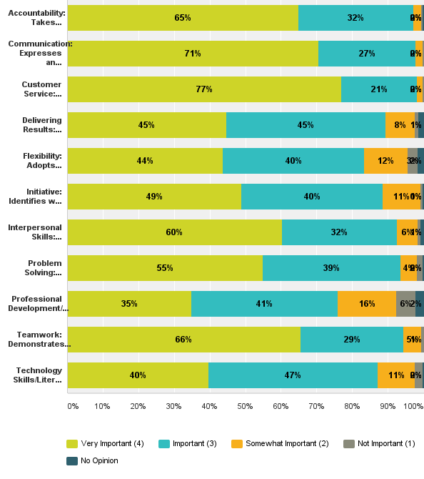
Competencies - Employee Only
Accountability
Communication
Customer Service
Delivering Results
Flexibility
Initiative
Interpersonal Skills
Problem Solving
Professional Development/
Learning Agility
Teamwork
Technology Skills/Literacy

Slide 21
Other competencies the Library should consider adding for all staff
Professionalism (proper attire, attendance, punctual, dependable, reliable, appropriate attitude) (4)
Developing community relationships; bridge-building (2)
Friendly and welcoming to internal and external members
Job knowledge
Managing change
Cultural sensitivity (religion, race, gender, socio-economic)
Other comments on competencies
Competencies should be job specific (3)
Notes:
53 comments

Slide 22
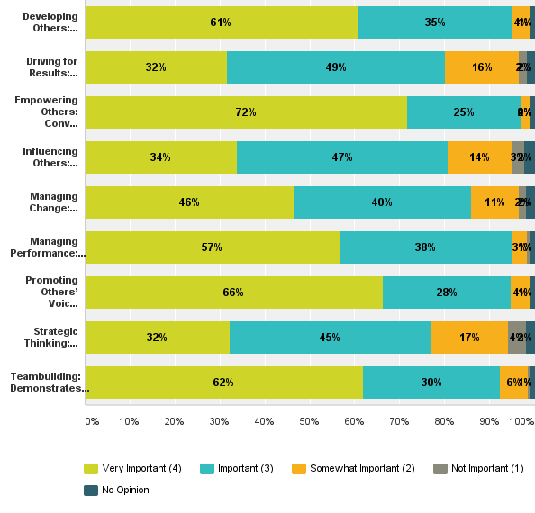
Competencies – Supervisors and Managers Only
Developing Others
Driving for Results
Empowering Others
Influencing Others
Managing Change
Managing Performance
Promoting Others’ Voices
Strategic Thinking
Teambuilding

Slide 23
Other competencies the Library should consider adding for supervisors/managers
Job knowledge for positions supervised (4); ability to jump in and perform when needed
Delegating (and not micromanaging) (3)
Respect employee differences (talents, learning styles, contributions) (3)
Appreciate and recognize employee performance (2)
Respect (2)
Integrity
Emotional intelligence
Fairness
Other comments on competencies
Supervisors
Notes:
65 comments

Slide 24
Single most important improvement that can be made to Metro’s performance management system
Shorter; more streamlined; less paperwork; easy to use (27); easier to use software
  Focus on most important aspects of the job vs. trying to address all aspects
More clearly tied to actual job duties; position specific; relevant (25)
Better way to recognize outstanding performers at all levels and give appropriate raises (24)
More opportunities for effective communication; consistent feedback (21)
Clearly defined expectations (15)
More consistency of application and standards (excellent vs. poor performance; across branches) (14); fairness
Positive reinforcement (11); should be a “performance development system”
Include goals (11); SMART goals
More than once a year (10); quarterly meetings, six month evaluations
Attainable measurable expectations (8)
Less specific (6), allowing managers to think creatively about employee performance
Upward appraisal (6)
Notes:
244 comments

Slide 25
Single most important improvement that can be made to Metro’s performance management system
Evaluate the individual; not the group (5); sensitivity to individual differences
Training (5)
No duplications and redundancies (4); staff should not be “dinged” for something more than once
More objective; less subjective (4); evaluate performance instead of the person
Tool for development; not a means to give bigger increases (4)
Accurate and consistent documentation of employee performance by the supervisor throughout the year (4)
More meaningful discussions; mentor; constructive feedback (3)
More accountability (3)
Stop changing duties so much so the evaluation system (and staff) can’t keep up (3)
Under performers should not get the same increase as over performers (3)
Employee should be able to make more than just a comment on the form if they disagree with their appraisal (better recourse) (2)
Focus on system goals/outcomes (vs. small tasks) (2)
Like the current system (2)
Notes:
244 comments

Slide 26
Single most important improvement that can be made to Metro’s performance management system
Do away with the monthly Activity Reports (2)
Significant increase in monetary raise amounts (2)
Peer evaluations (2)
Current kudo system should not be part of the performance evaluation
3% should not be the maximum raise an employee can earn
Advancement opportunities based on performance
Standards should be updated to reflect the goals of Library Unbound, core values and the alignment
Coaching
Stop formal evaluations
Self evaluations
Offer free EAP counseling sessions
Notes:
244 comments

Slide 27
Additional Comments – Performance Management
Skills should be rewarded just as much as
education is
Consider re-evaluating the system every few
years

Slide 28
Additional Comments – Compensation/Classification
Salaries should be adjusted to reflect cost of living increases (8)
Compensation should match level of responsibility (6)
Overall pay is good (5)
Changes in the lower education requirements should not lower the pay as the
responsibilities are still the same (4)
Compensation at the administrative level seems high (3)
Need to address compression (2)
Compensation and classification is fair until you reach the supervisor level
Adjust pay to reflect significantly increased workload
Recognize continued employment if meeting or exceeding expectations (longevity
pay)
Need a clearer understanding of new classifications
Notes:
120 responses

Slide 29
Additional Comments – Compensation/Classification
PT staff should receive the same benefits as FT staff, just prorated
Make salary adjustments retroactive to May (for positions started then as
part of the alignment)
Communication on compensation policies so staff know when, why, how they will
receive increases
Where desks are unified the staff working the desk should be paid the same
The new alignment will have significant impact on jobs and the comp study will
need to take the new roles into account and compensate for them
Decrease benefit costs or increase hourly wages to compensate
Provide differential for Spanish language
Notes:
120 responses

Slide 30
Additional Comments – Miscellaneous
Low morale is not a result of big system changes it is a result of an unfair evaluation system and several new high salaried administrative positions
The library has very high expectations of staff but limited organized training
Need to allow for time to learn and adjust to new changes before they are implemented
Create less PT jobs and more FT jobs

Slide 31
QUESTIONS?
THANK YOU!
Paula M. Singer, PhD – pmsinger@singergrp.com
Lorraine Kituri, MS – lkituri@singergrp.com
Colleen Shannon, SPHR – cshannon@singergrp.com
12915 Dover Road, Reisterstown, MD 21136 ~ 410.561.7561 www.singergrp.com

